Slide 1
ECE & I SEM
MICROWAVE ENGINEERING
MWE
I
Dr. C. PADMA

Slide 2
OUTLINE
What is MICROWAVE?
History of MICROWAVES
Frequency Bands, EM Spectrum
Microwave Advantages, Applications
Waveguide Types, Field components of Rectangular waveguide
TM Mode Analysis
TE Mode Analysis
Waveguide Parameters
Cavity Resonator, Power Transmission and losses
Microstriplines

Slide 3
WHAT IS MICROWAVE
INTRODUCTION TO MICROWAVE:
Microwaves are the electromagnetic waves whose frequencies rang from 1GHz to 1000GHz. Micro waves are also called as tinyness (small) waves due to their wave length that is in terms of 1 meter to 1millimeter.
  ranging from as long as one meter to as short as one millimeter, or equivalently
  broad definition in terms of frequencies between 300 MHz and 300 GHz according to electro magnetic spectrum.
A definite relationship exists between the frequency (f) and the corresponding wavelength (λ) of electromagnetic waves .
The product of these two i.e. (f) and (λ) gives the velocity of propagation of electro-magnetic waves and it is equal to the velocity of light .
This is expressed as c = f * λ
c= velocity of light. (approx. 3* 108 m/sec ).

Slide 4
HISTORY OF MICROWAVES
HOW IT ALL BEGAN:
1831-1879: James Clerk Maxwell Unified Theory
1857-1937: Hertz Demonstration of Electromagnetic waves
1900: Tesla Radio Technology (HF & VHF)
1906: Lee de Forest Triode
1921: Albert Hull Magnetron
1937: Varian brothers (R.H&S.F) Klystron & Oscillator
1939: Robert Watson Watt Radar (Military applications in world war-II)
1940: Randoll & Boot Cylindrical Magnetron
1943: Kompfner TWT (helix)
1960: Twiss & Schneider Gyrotron, solid state microwave sources
1970: Hybrid MIC
1990: Monolithic MIC (More Popular)

Slide 5
HISTORY OF MICROWAVES
Conventional Vacuum tube (Triodes, Tetrodes, Pentodes) was best
  Can’t be used for frequencies greater than 100 MHz because of following effects
  IEC –Inter electrode capacitance
    Solved by Special Vacuum Tube: Barkhausen-Kurz Oscillator (BKO) but low output power developed by K. Kurz and H. Barkhausen in 1920
    Magnetron developed by A. W. Hull in the year 1921 and further developed by Randoll & Boots in1939.
In 1960’ s Microwave Communication
In 1980’s Microwave devices used in the consumer market products
In 1990’s Microwave became common consumer market products

Slide 6
FREQUENCY Ranges (Microwave Frequency Spectrum)
IEEE Standards
Frequency Range | Band Designation | Applications
3-30 Hz | Ultra Low Frequency (ULF)
30-300 Hz | Extra Low Frequency (ELF) | Communication with submarines
300-3000 Hz | Super Low Frequency (SLF) | Voice Communication
3K-30 KHz | Very Low Frequency (VLF) | Long distance point to point communication
30K-300 KHz | Low Frequency (LF) | point to point marine communication and broadcast
300K-3000 KHz | Medium Frequency (MF) | Used for Radio broadcasting.
3M-30 MHz | High frequency (HF) | Long distance communication
30M-300 MHz | Very High frequency (VHF) | FM Radio, Television broadcasting.
300M-3000 MHz | Ultra High Frequency (UHF) | Short Distance communication including RADAR
3G-30 GHz | Super High Frequency (SHF) | RADAR, Microwave and Space Communication
30G-300 GHz | Extra High Frequency (EHF) | RADAR, Microwave and Space Communication

Slide 7
FREQUENCY BANDS
Frequency Range | Band Designation
300G-3000 GHz | Infrared Light
3T-30 THz
30T-300 THz
300T-3000 THz | Visible Light
3P-30 PHz | Ultra Violet Light
30P-300 PHZ | X-Rays
300P-3000 PHz | Gamma Rays
3E-30 EHz | Cosmic Rays
G - Giga-10⁹ T - Tera-10¹² P - Peta-10¹⁵ E - Exa-10¹⁸

Slide 8
MICROWAVE FREQUENCY BANDS
Band Designation | Frequency Range(GHz) | Applications
L band | 1-2 | GSM, Marine satellite
S band | 2-4 | Weather and surface ship RADAR, Microwave oven, Bluetooth, ZigBee, Wi-Fi.
C band | 4-8 | Satellite Communication
X band | 8-12 | Educational Purpose
Ku band | 12-18 | Satellite TV and VSAT
K band | 18-27 | RADAR, Armature Satellite, Infrared Astronmy
Ka band | 27-40 | Satellite Communication, High resolution and low range RADAR

Slide 9
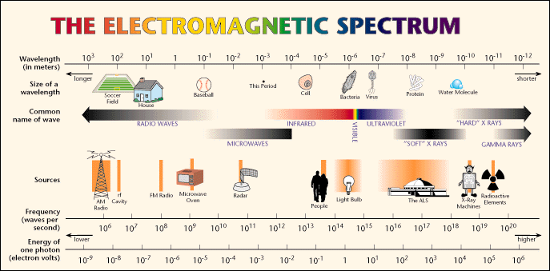
EM SPECTRUM

Slide 10
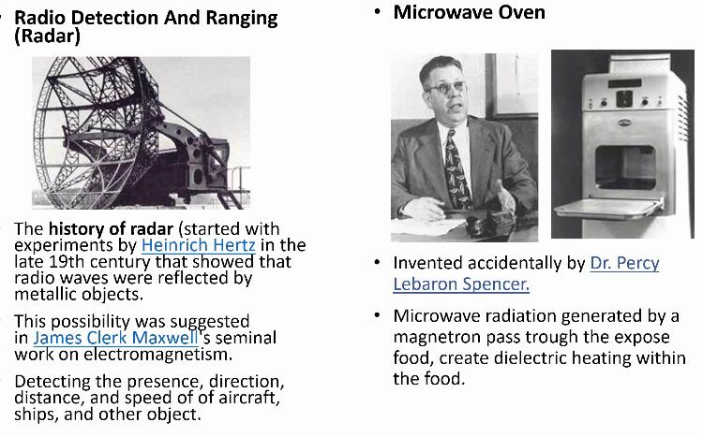
MICROWAVE APPLICATIONS

Slide 11
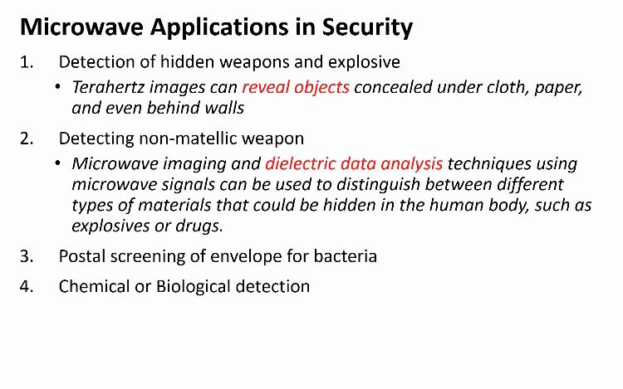

Slide 12
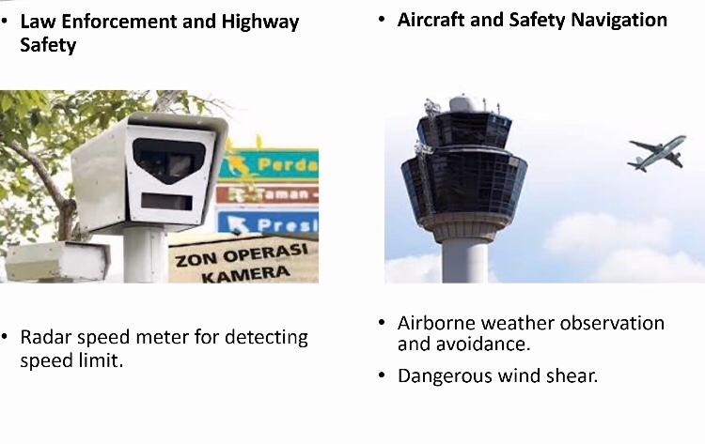
MICROWAVE APPLICATIONS

Slide 13
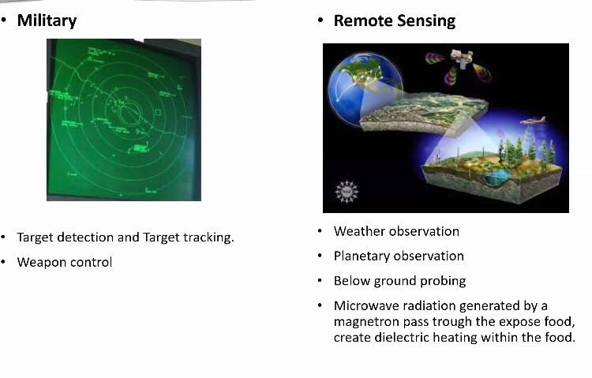
MICROWAVE APPLICATIONS

Slide 14
ADVANTAGES OF MICROWAVES
Large Bandwidth:
The Bandwidth of Microwaves is larger than the common low frequency radio waves. Thus more information can be transmitted using Microwaves. It is very good advantage, because of this, Microwaves are used for Point to Point Communications.
Improved Directivity:
As frequency increases , directivity increases and bandwidth decreases. Hence the bandwidth of radiation θ is directly proportional to λ/D. At low frequency bands, the size (diameter) of the antenna becomes very large if it is requires to get sharper beams of radiation. B=140⁰/(D/λ)
Transparency Window: Microwave frequency band ranging from 300 MHZ – 10 GHZ are capable of freely propagating through the ionized layers surrounding the earth as well as through the atmosphere.

Slide 15
Power Consumption: The power required to transmit a high frequency signal is lesser than the power required in transmission of low frequency signals. As Microwaves have high frequency thus requires very less power.
Effect Of Fading Reliability: The effect of fading is minimized by using Line Of Sight propagation technique at Microwave Frequencies. While at low frequency signals, the layers around the earth causes fading of the signal
WAVEGUIDE:
A hollow metallic tube of the uniform cross section for transmitting electromagnetic waves by successive reflections from the inner walls of the tube is called as a Waveguide.
Microwaves propagate through microwave circuits, components and devices, which act as a part of Microwave transmission lines, broadly called as Waveguides.

Slide 16
WAVEGUIDE
A waveguide is generally preferred in microwave communications. A waveguide is a special form of a transmission line, which is a hollow metal tube. Unlike the transmission line, the waveguide has no center conductor.
ADVANTAGES OF WAVEGUIDES:
Waveguides are easy to manufacture.
They can handle very large power (in kilowatts)
Power loss is very negligible in waveguides
They offer very low loss ( low value of alpha-attenuation)
The microwave energy when travels through the waveguide, experiences lower losses than a coaxial cable

Slide 17
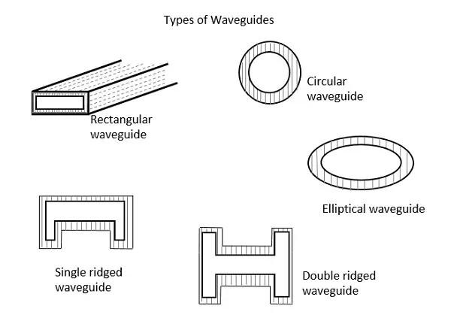
TYPES OF WAVEGUIDES
There are five types of wave guides. They are:
Rectangular wave guide
Circular wave guide
Elliptical wave guide
Single ridged wave guide
Double ridged wave guide
Fig 1.1 Types of Waveguide

Slide 18
TRANSMISSION LINES VS WAVEGUIDES
The main difference between a transmission line and a wave guide is −
A two conductor structure that can support a TEM wave is a transmission line.
A one conductor structure that can support a TE wave or a TM wave but not a TEM wave is called as a waveguide.
Transmission Lines | Waveguides
Supports TEM wave | Cannot support TEM wave
All frequencies can pass through | Only the frequencies that are greater than cut-off frequency can pass through
Two conductor transmission | One conductor transmission
Reflections are less | Wave travels through reflections from the walls of waveguide
It has characteristic impedance | It has wave impedance
Propagation of waves is according to "Circuit theory" | Propagation of waves is according to "Field theory"
It has a return conductor to earth | Return conductor is not required as the body of the waveguide acts as earth
Bandwidth is not limited | Bandwidth is limited

Slide 19
RECTANGULAR WAVEGUIDES
Rectangular waveguides are the one of the earliest type of the transmission lines.
They are used in many applications. A lot of components such as isolators, detectors, attenuators, couplers and slotted lines are available for various standard waveguide bands between 1 GHz to above 220 GHz.
A rectangular waveguide supports TM and TE modes but not TEM waves because we cannot define a unique voltage since there is only one conductor in a rectangular waveguide.
MODES OF PROPAGATION:
TEM (E_{z}=H_{z}=0) can’t propagate.
TE (E_{z}=0) transverse electric
TM (H_{z}=0) transverse magnetic, E_{z} exists

Slide 20
MODES OF WAVE GUIDES:
RECTANGULAR WAVEGUIDES
WAVEGUIDE MODES
Looking at waveguide theory it is possible it calculate there are a number of formats in which an electromagnetic wave can propagate within the waveguide. These different types of waves correspond to the different elements within an electromagnetic wave.
TE MODE: This waveguide mode is dependent upon the transverse electric waves, also sometimes called H waves, characterized by the fact that the electric vector (E) being always perpendicular to the direction of propagation. In TE wave only the E field is purely transverse to the direction of propagation and the magnetic field is not purely transverse i.e. Ez=0,Hz#0

Slide 21
TM mode: Transverse magnetic waves, also called E waves are characterized by the fact that the magnetic vector (H vector) is always perpendicular to the direction of propagation. In TM wave only the H field is purely transverse to the direction of propagation and the Electric field is not purely transverse i.e. Ez#0,Hz=0
TEM mode: The Transverse electromagnetic wave cannot be propagated within a waveguide, but is included for completeness. It is the mode that is commonly used within coaxial and open wire feeders. The TEM wave is characterized by the fact that both the electric vector (E vector) and the magnetic vector (H vector) are perpendicular to the direction of propagation i.e. Ez=0, Hz=0.
Hybrid Wave (HE): In this neither electric nor magnetic fields are purely transverse to the direction of propagation. i.e. Ez#0, Hz#0

Slide 22
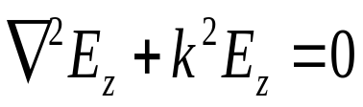
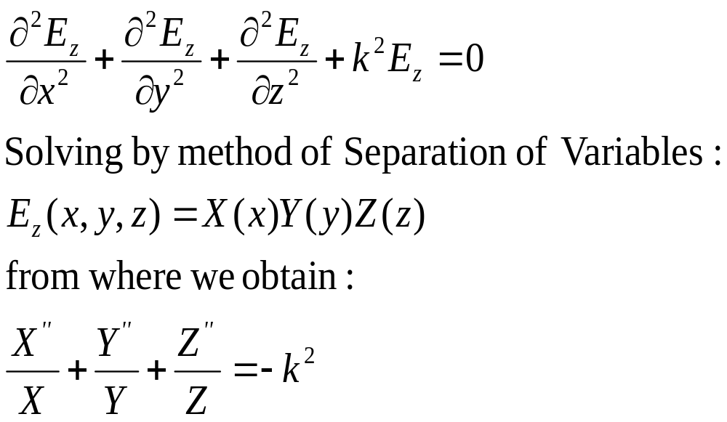
THEN APPLYING ON THE Z-COMPONENT
SOLUTION OF WAVE EQUATION IN RECTANGULAR W/G

Slide 23
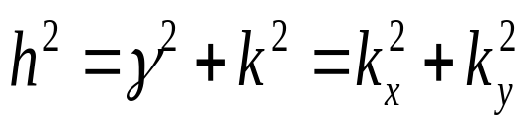
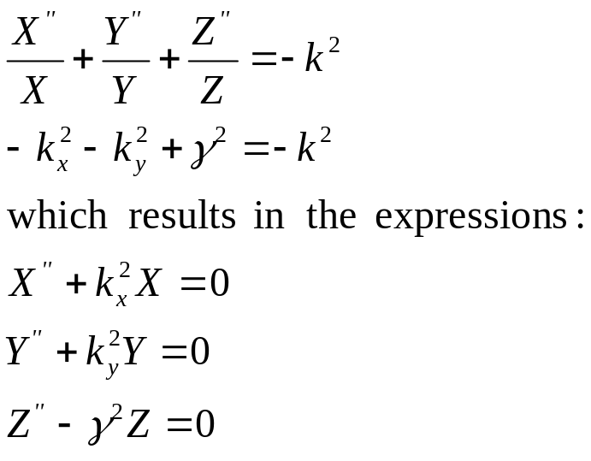
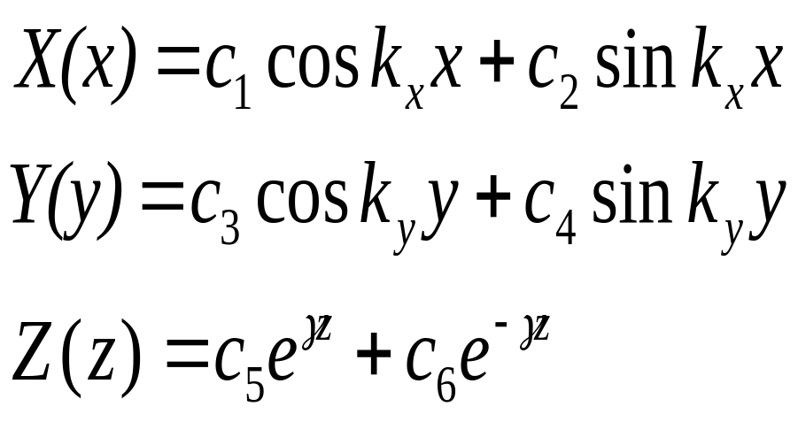
FIELDS INSIDE THE WAVEGUIDE
SOLUTION OF WAVE EQUATION IN RECTANGULAR W/G
Notes:
Dr. Sandra Cruz-Pol
Electromagnetics, waveguides

Slide 24
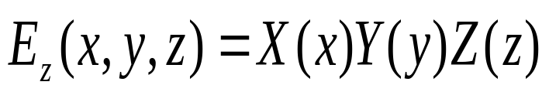
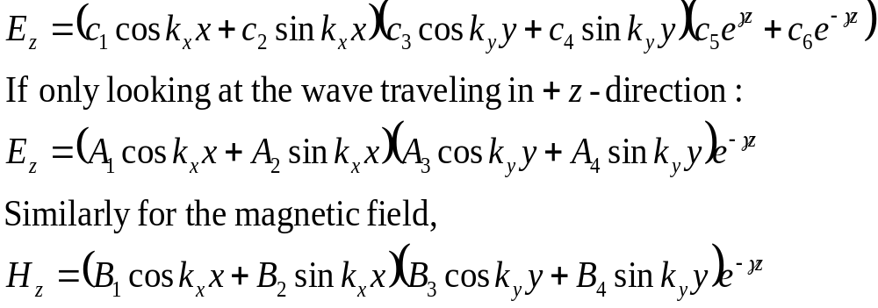
Substituting
Notes:
Dr. Sandra Cruz-Pol
Electromagnetics, waveguides

Slide 25
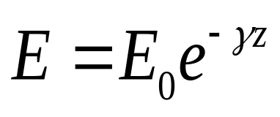

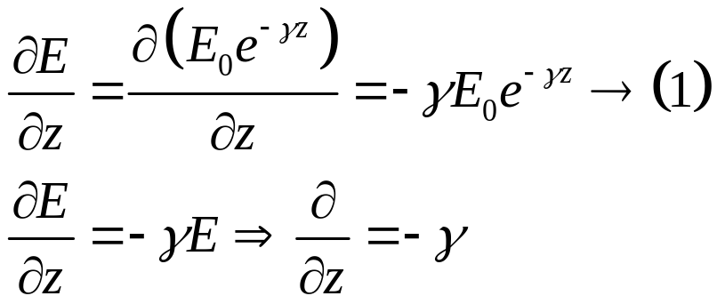
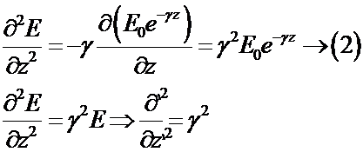
WAVE EQUATIONS:
= max value of electric field intensity
Partially with respect to z we get
Partial differentiation with respect to z from (1) we get

Slide 26
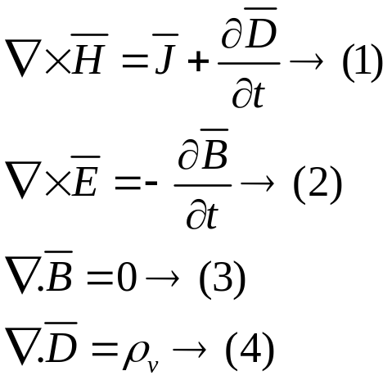
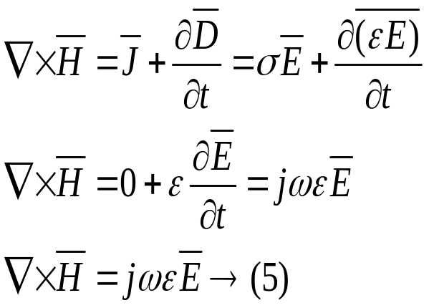
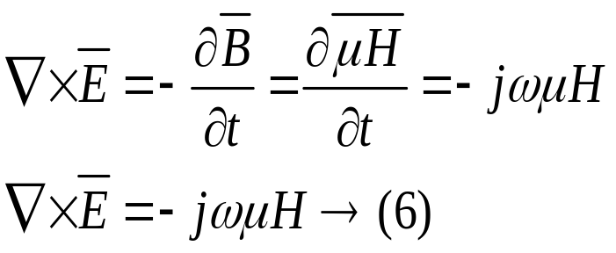

From Maxwell’s 1st equation
From Maxwell’s 2nd equation
Taking curl on both sides

Slide 27
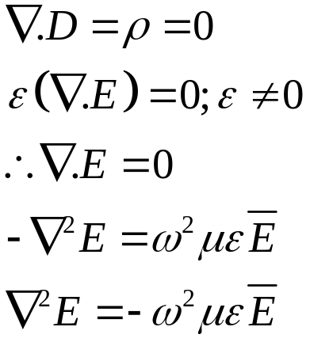

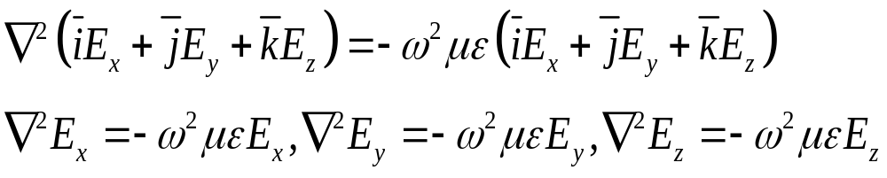

From Maxwell’s 3rd equation
Resolving
into 3 mutually perpendicular directions, we get

Slide 28
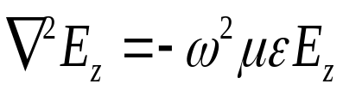

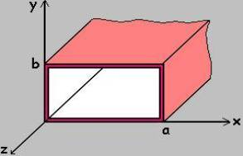
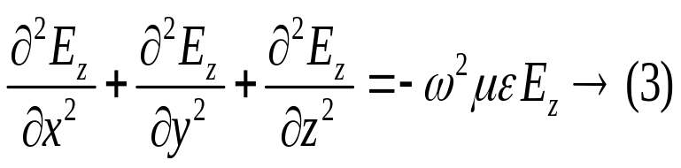
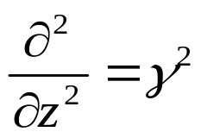
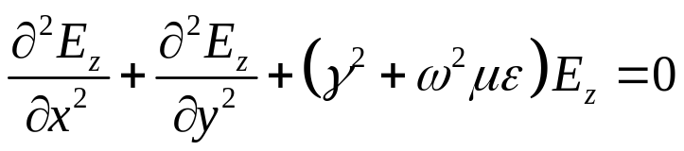
PROPAGATION OF WAVES IN RECTANGULAR WAVEGUIDE:
Consider a rectangular waveguide is situated in the rectangular coordinate system with its breadth along x-axis, width y-axis and the wave is assumed to propagate along the z-direction. Waveguide is filled with air as dielectric. As shown in fig.
The wave equation for TE and TM waves are given by
for TM waves →(1)
for TE waves →(2)
Since the wave is propagating in the z direction we have
the operator
Substitute in eq (3)
Fig 1.2 Rectangular waveguide

Slide 29
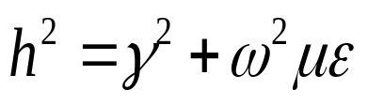
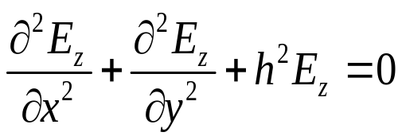


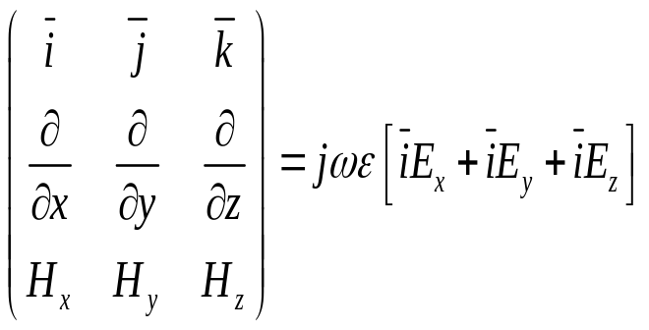
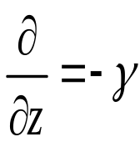
be a constant
for TM wave
Using Maxwell’s equation it is possible to find the various components along x and y directions (E_{x} ,E_{y},H_{x},H_{y})
From Maxwell’s 1st equation, we have
Expand
Replacing

Slide 30
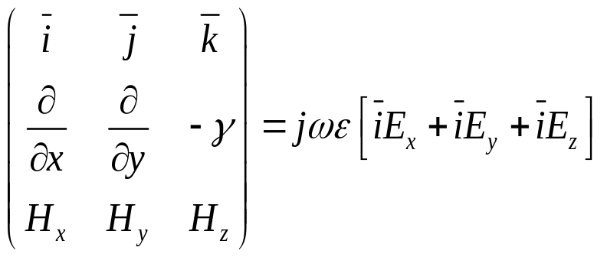

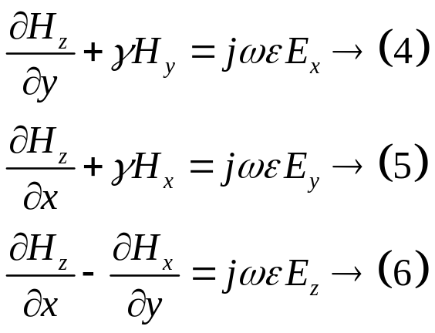
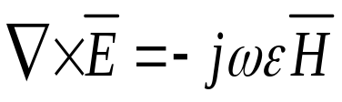
Equating coefficients of
Similarly from Maxwell’s 2nd equation

Slide 31
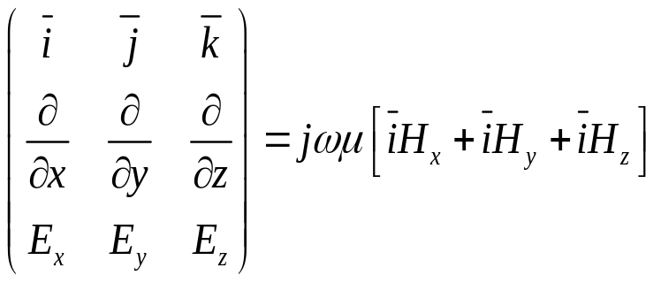
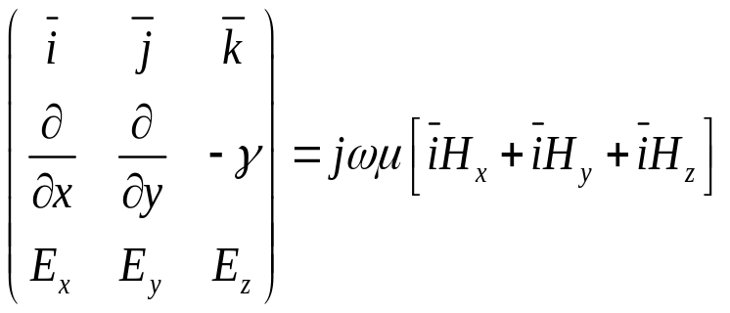
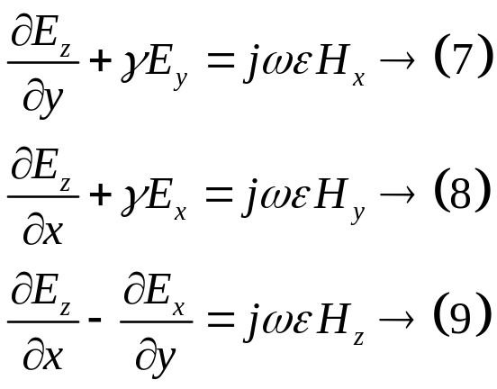
Expanding and equating coefficients

Slide 32
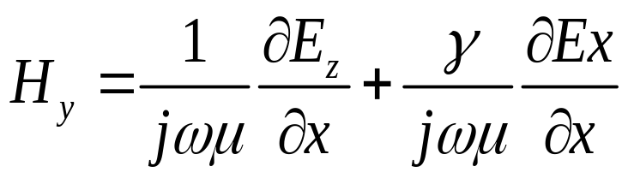
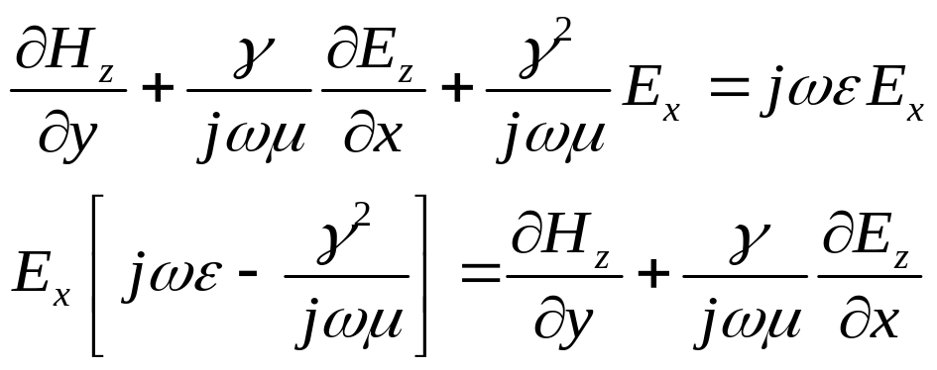

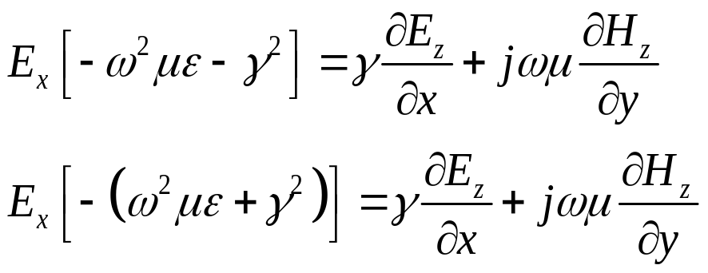
Combining equation (4) and (8) to eliminate H_{y} we get an expression for E_{x}
Substituting for H_{y} in equation (4)
Multiplying by

Slide 33
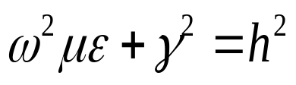
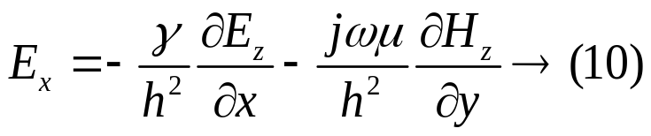
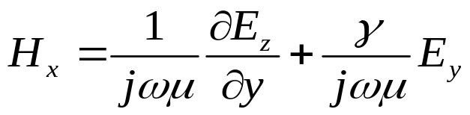
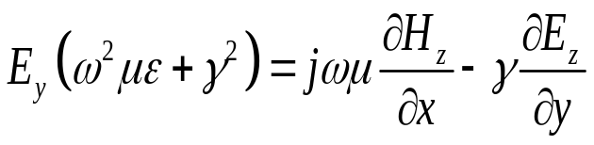

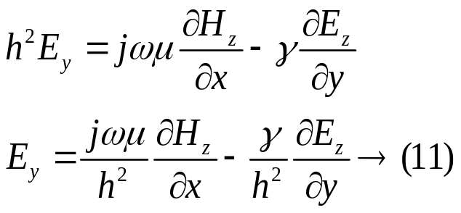
Where
Dividing by –h² throughout we get
Combining equation (5) and (7) to eliminate H_{y} we get an expression for E_{x}
Substituting for H_{x} in eq (5)

Slide 34
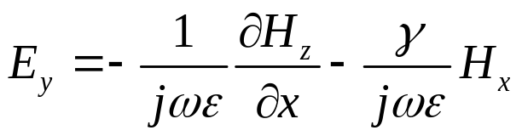
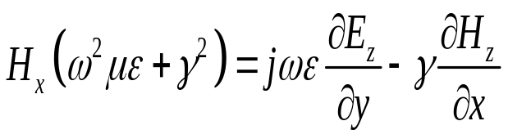
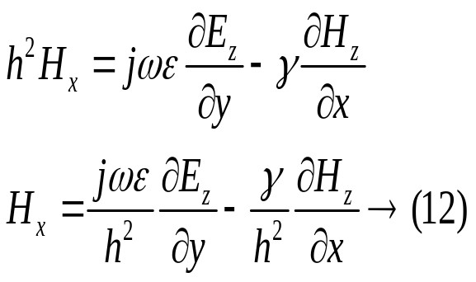
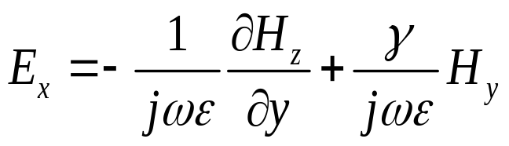
Combining equation (4) and (8) to eliminate E_{y} we get an expression for H_{x}
Substituting for E_{y} in equation (8)
Combining equation (7) and (5) to eliminate E_{x} we get an expression for H_{y}

Slide 35
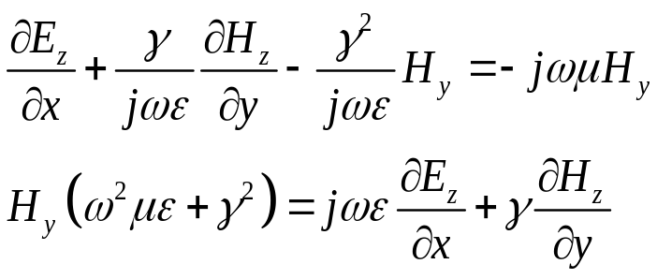

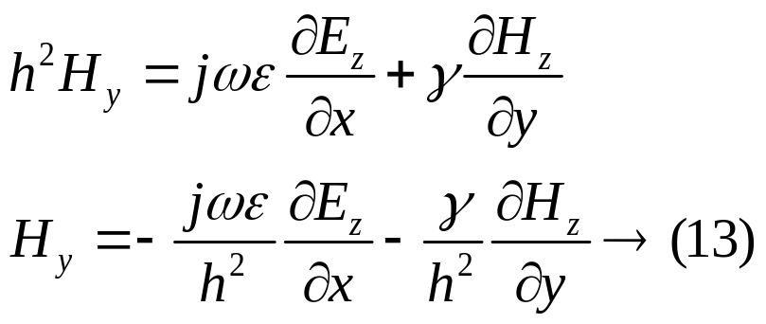
Substituting for E_{x} in equation (7)

Slide 36

From Faraday and Ampere Laws we can find the remaining four components:
*So once we know E_{z} and H_{z}, we can find all the other fields.
Notes:
Dr. Sandra Cruz-Pol
Electromagnetics, waveguides

Slide 37
MODES:
The electromagnetic wave inside a waveguide can have an infinite number of patterns which are called modes.
The electric field cannot have a component parallel to the surface i.e. the electric field must always be perpendicular to the surface at the conductor.
The magnetic field on the other hand always parallel to the surface of the conductor and cannot have a component perpendicular to it at the surface.

Slide 38



TM MODE ANALYSIS IN RECTANGULAR WAVEGUIDES
TM WAVES :
For TM waves
The wave equation of a TM wave is
This is a partial differential equation which can be solved to get the different components
E_{x} ,H_{y} , E_{y,} H_{x} by separation of variables method.
Let us assume a solution E_{z} = XY
Where X is a pure function of ‘x’ only , Y is a pure function of ‘y’ only
Since X and Y are independent variables

Slide 39







Dividing throughout by XY, in equation (1) we get
is a pure function of ‘x’ only
is a pure function of ‘y’ only.
Where -A² and -B² are constants -A² - B² +h² =0
-A² - B² =h² →(6)
Ordinary 2nd order differential equations the solutions are given by
Where C_{1,} C_{2,} C_{3,} C₄ are constants which can be evaluated by applying the boundary conditions.
The complete solution is given by E_{z} =XY, Substituting the values of X and Y
E_{z} =

Slide 40

BOUNDARY CONDITIONS:
The entire surface of the rectangular waveguide acts as a short
Circuit or ground for electric field , Ez =0 all along the boundary
walls of the waveguide
So that E_{Z}=0 but we have components along x and y direction.
E_{X}=0 waves along bottom and top walls of the waveguide
E_{y}=0 waves along left and right walls of the waveguide
1st Boundary condition: E_{X}=0 at y=0 ∀ x→ 0 to a(bottom wall)
2nd Boundary condition : E_{X}=0 at y=b ∀ x→ 0 to a (top wall)
3rd Boundary condition : E_{y}=0 at x=0 ∀ y→ 0 to b (left side wall)
4th Boundary condition: E_{y}=0 at x=a ∀ y→ 0 to b (right side wall)
Fig 1.3 Rectangular waveguide

Slide 41





(i) Substituting 1st boundary condition in equation (9) given by
E_{z} =0 at y=0 for all x → 0 to a
The solution reduces to
(ii) Substituting 3rd boundary condition in equation (10) given by
E_{z} =0 at x=0 for all y → 0 to b
The solution reduces to

Slide 42



(iii)Substituting 2nd boundary condition in equation (11) given by
E_{z} =0 at y=b for all x → 0 to a
Ab= a multiple of π =nπ Where n is a constant n =0,1,2,3……….
A =
→(12)
(iv) Substituting 4th boundary condition in equation (11) given by
E_{z} =0 at x=a for all y → 0 to b
Ba = mπ , Where m is a constant m =0,1,2,3 ………..
B =
→(13)
The complete solution is given by

Slide 43




Substituting B and A values in the above equation is
Where
e^{-γz} =propagation along z direction e^{jωt} = sinusoidal variation wrt t
Let C₂ C₄ = C some other constant
Since E_{z} is known E_{x,} E_{y,} H_{x,} H_{y} are given by
(for TM wave H_{z} = 0)

Slide 44

FIELD COMPONENTS:

Slide 45
TM MODES IN RECTANGULAR WAVEGUIDES:
Depending on the values of m and n, we have various modes in TM waves.
Various TM_{mn} modes:
TM₀₀ mode: m= 0 and n =0
If m =0 and n=0 are substituted in E_{x} ,H_{y} , E_{y,} and H_{x}. all of them vanish and
hence TM₀₀ mode cannot exist.
TM₀₁ mode: m =0 and n=1
Again , all the field components vanish and hence TM₀₁ mode cannot exist.
TM₁₀ mode: m =1 and n=0
Even now , all the field components vanish and hence TM₁₀ mode cannot exist.
TM₁₁ mode: m=1 and n=1
All the four components E_{x} ,H_{y} , E_{y,} and H_{x} i.e TM₁₁ mode exists and for all
higher values of m and n , the components exist i.e. all higher modes do exist.

Slide 46


TE MODE ANALYSIS IN A RECTANGULAR WAVEGUIDES:
TE WAVES :
The TE_{mn} modes in a rectangular waveguide are characterized E_{z} = 0.
The magnetic field H_{z} , must exist in order to have energy transmission in the guide.
The wave equation for TE wave is given by

Slide 47
This is a partial differential equation whose solution can be assumed H_{z} =XY
Where X is a pure function of ‘x’ only, Y is a pure function of ‘y’ only
Since X and Y are independent variables
Dividing throughout by XY, in equation (1) we get
Where -A² and -B² are constants -A² - B² +h² =0
-A² - B² =h² →(6)

Slide 48
Ordinary 2nd order differential equations the solutions are given by
Where C_{1,} C_{2,} C_{3,} C₄ are constants which can be evaluated by applying the boundary conditions.
The complete solution is given by H_{z} =XY
Substituting the values of X and Y
H_{z} =
BOUNDARY CONDITIONS:
Since we consider a TE wave propagating along z direction.
So E_{Z}=0 but we have components along x and y direction.
E_{X}=0 waves along bottom and top walls of the waveguide
E_{y}=0 waves along left and right walls of the waveguide

Slide 49


1st Boundary condition:
E_{X}=0 at y=0 ∀ x→ 0 to a(bottom wall)
2nd Boundary condition
E_{X}=0 at y=b ∀ x→ 0 to a (top wall)
3rd Boundary condition
E_{y}=0 at x=0 ∀ y→ 0 to b (left side wall)
4th Boundary condition
E_{y}=0 at x=a ∀ y→ 0 to b (right side wall)
(i) Substituting 1st boundary condition in equation (9)
Since 1st boundary condition is E_{x} =0 at y=0, for all x→0 to a

Slide 50




Substituting 1st boundary condition in the above equation
The solution reduces to
(ii) 3rd boundary condition
Substituting the 3rd boundary condition
x =0, y→0 to b

Slide 51




The solution now reduces to
(iii) 2nd boundary condition E_{z} =0 at y=b, for all x→0 to a
Substituting 2nd boundary condition

Slide 52



(iv) 4th boundary condition E_{y} =0 at x=a, for all y→0 to b
Substituting the boundary condition
The complete solution is

Slide 53


Substitute for A and B values
FIELD COMPONENTS:

Slide 54


Slide 55
TE MODES IN RECTANGULAR WAVEGUIDES:
TE_{mn} is the general mode
TE₀₀ mode: m=0, n=0
all field components vanish, therefore it cannot exist
TE₀₁ mode: m=0, n=1
E_{y} =0, H_{x} =0 E_{x} and H_{y} exist
TE₁₀ mode: m=1, n=0
E_{x} =0, H_{y} =0 E_{y} and H_{x} exist Therefore TE₁₀ mode exists
TE₁₁ mode: m=1, n=1
This also exists and ever higher modes
DOMINANT MODE:
Dominant mode is that mode for which the cutoff wavelength assumes (λ_{c})maximum value.

Slide 56


TE₁₀ mode is the dominant mode in rectangular waveguide.
The expressions for β, v_{p,} v_{g}, and λ_{g} remains the same for TM,TE waves

Slide 57



CUT-OFF FREQUENCY and Filter characteristics
At lower frequencies γ> 0
γ then becomes real and positive and equal to the attenuation constant αi.e. the wave is completely attenuated and there is no phase change.
Hence the wave cannot propagate. However at higher frequencies the RWG acts

Slide 58


The frequency at which γ just becomes zero is defined as the cutoff frequency
(or threshold frequency ) f_{c}.
At f = f_{c}, γ =0 or ω =2πf_{c} =ω_{c}

Slide 59

The cutoff frequency λ_{c} is
All wavelengths greater than λ_{c} are attenuated and those less than λ_{c} are allowed to
propagate inside the waveguide.

Slide 60



GUIDED WAVELENGTH (λG):
It is defined as the distance travelled by the wave in order to undergo a phase shift of 2π radians.
It is related to phase constant by the relation λg=2π/β the wavelength in the waveguide is different from the wavelength in free space.
Guide wavelength is related to free space wavelength λ0 and cut-off wavelength
(1) λ₀ « λ_{c} , λ_{g} = λ₀
(2) λ₀ = λ_{c} , λ_{g} increases and reaches infinity.
(3) λ₀ > λ_{c} it is evident that λ_{g} is imaginary, no propagation in the waveguide.

Slide 61




PHASE VELOCITY(V_{P}):
,
Wave propagates in the waveguide when guide wavelength λ_{g} is grater than the free space wavelength λ₀.
In a waveguide, v_{p}= λ_{g}f where vp is the phase velocity. But the speed of light is equal to product of λ₀ and f.
This vp is greater then the speed of light since λ_{g}> λ₀.
It is defined as the rate at which the wave changes its phase in terms of the guide wavelength.
where

Slide 62





GROUP VELOCITY(V_{G} ):
The rate at which the wave propagates through the waveguide and is given by V_{g}=dω/dβ
EXPRESSION FOR PHASE VELOCITY AND GROUP VELOCITY:
EXPRESSION FOR V_{P} :

Slide 63



Slide 64

Fig 1.4 Variation of group velocity with frequency
Notes:
2003 03 17

Slide 65





EXPRESSION FOR V_{G} :
Differentiating
wrt ω we get

Slide 66


The product of v_{p} and v_{g} is
Relation between λ_{g} , λ₀ and λ_{c} :

Slide 67


WAVE IMPEDANCE
WAVE IMPEDANCE Z_{Z} IN TM AND TE WAVES:
Wave impedance is defined as the ratio of the strength of electric field in one transverse direction to the strength of the magnetic field along the other transverse direction as shown in fig.
z
H_{y}
E_{x}
WAVE IMPEDANCE FOR A TM WAVE IN RECTANGULAR WAVEGUIDE:
For a TM wave H_{z} =0, γ=jβ

Slide 68


Slide 69


Where η is the intrinsic impedance of free space.
WAVE IMPEDANCE FOR A TE WAVE IN RECTANGULAR WAVEGUIDE:
For a TE wave E_{z} =0, γ=jβ

Slide 70


Slide 71


Z_{TE} > η as λ₀ < λ_{c} for wave propagation.
The wave impedance for a TE wave is always greater than free space.
For TEM waves between parallel plane or an ordinary parallel wire or coaxial transmission lines the cutoff frequency is zero and wave impedance for TEM wave is the free space impedance.
Z_{z} (TEM) = η
When the waveguide has a dielectric other than air with a dielectric constant ε_{r} then the behavior of the waveguide gets changed.

Slide 72
CAVITY RESONATORS
A cavity resonator is a metallic enclosure that confines the electromagnetic energy i.e.
when one end of the waveguide is terminated in a shorting plate there will be reflections and hence standing waves.
When another shorting plate is kept at a distance of a multiple of λg/2 than the hollow space so form can support a signal which bounces back and forth between the two shorting plates.
This results in resonance and hence the hollow space is called “cavity” and the resonator as the ‘cavity resonator’
The waveguide section can be rectangular or circular.
The microwave cavity resonator is similar to a tuned circuit at low frequencies having a Resonant frequency
f0= 1 /2𝜋√𝐿𝐶
The cavity resonator can resonate at only one particular frequency like a parallel resonant circuit.

Slide 73


The stored electric and magnetic energies inside the cavity determine it’s equivalent inductance and capacitance.
The energy dissipated by the finite conductivity of the cavity walls determines it’s equivalent resistance.
A given resonator has an infinite number of resonant modes and each mode corresponds to a definite resonant frequency.
When the frequency of an impressed signal is equal to a resonant frequency a maximum amplitude of the standing wave occurs and the peak energies stored in the electric and magnetic fields are equal.

Slide 74
The mode having the lowest resonant frequency is called as the ‘Dominant mode’
The wave equations in the rectangular resonator should satisfy the boundary condition of the zero tangential ‘E’ At four of the walls.
TE WAVES:
For a TE wave Ez=0,Hz#0 From Maxwell’s equation
∇²H_{z}= -ω²μϵ H_{z}
𝜕² H_{z}/𝜕𝑥²+ 𝜕² H_{z}/𝜕𝑦²+ 𝜕² H_{z}/𝜕𝑧²= - ω²μϵ H_{z}
Since 𝜕² /𝜕𝑧² = γ²
𝜕² H_{z}/𝜕𝑥²+ 𝜕² H_{z}/𝜕𝑦²+(γ²+ ω²μϵ) H_{z}=0 Let γ²+ ω²μϵ=h²

Slide 75
𝜕² H_{z}/𝜕𝑥²+ 𝜕² H_{z}/𝜕𝑦²+ h²H_{z}=0-----------(1)
This is a partial differential equation of 2nd order
H_{z}= XY-------------(2)
Where X is a function of ‘x’ alone, Y is a function of ‘y’ alone
Y 𝜕² X/𝜕𝑥²+X 𝜕² Y/𝜕𝑦²+ h²XY=0
1/X 𝜕² X/𝜕𝑥²+1/Y 𝜕² Y/𝜕𝑦²+ h²=0------------(3)
Where h² is a constant
Let
since γ² and ω²μϵ are constants. So to satisfies the above equation sum of functions of ‘X’ and ‘Y’ must be equalent to a constant.
It is possible when individual one must be a constant.
Let 1/X 𝜕² X/𝜕𝑥²= -B2 ,
1/Y 𝜕² Y/𝜕𝑦²= -A2--------(4)

Slide 76
Where A² and B² are constants
-A²-B²+ h²=0
h²= A²+B²------------(5)
solutions of equation (4) are X=c1cosBx+c2sinBx------------(6)
Y=c3cosAy+c4sinAy------------(7)
Where c1,c2,c3 and c4 are constants Which are determined by applying boundary conditions
I) BOUNDARY CONDITION(BOTTOM WALL)
Ex=0 for y=0 and all values of x varying from 0 to a we know
Ex= -γ/h²𝜕𝐸z/𝜕𝑥-jωμ/h²𝜕𝐻z/𝜕𝑦 Since Ez=0
Ex= -jωμ/h2𝜕𝐻z/𝜕𝑦
Ex= -jωμ/h2 𝜕/𝜕𝑦[(c1cosBx + c2sinBx)(c3cosAy+c4sinAy)]
= -jωμ/h2[(c2sinBx+c1cosBx)(-Ac3sinAy+Ac4cosAy)]

Slide 77
From the boundary condition(i) 0= -jωμ/h2[c1cosBx+c2sinBx]Ac4 [c1cosBx+c2sinBx]Ac4=0 c1cosBx+c2sinBx #0
A#0, c4=0
Hz=( c1cosBx+c2sinBx)(c3cosAy)
Hz= c3(c1cosBx+c2sinBx)cosAy
ii) 2ND BOUNDARY CONDITION[LEFT SIDE WALL] E_{y}=0 for x=0 and y varying from 0 to b. Since
E_{y}= jωμ/h² 𝜕𝐻_{z}/𝜕𝑥
E_{y}= jωμ/h²𝜕/𝜕𝑥[(c1cosBx+c2sinBx)c3cosAy]
E_{y}= jωμ/h²[-Bc1sinBx+Bc2cosBx]c3cosAy From the boundary condition
0= jωμ/h²[Bc2c3cosBxcosAy] c3cosAy#0,
c2=0
H_{z}= c1cosBx.c3cosAy

Slide 78
3RD BOUNDARY CONDITION[TOP WALL] E_{x}=0 for y=b and x varies from 0 to a
E_{x}= -jωμ/h² 𝜕𝐻z/𝜕𝑦
E_{x}= -jωμ/h² 𝜕[𝑐1𝑐3𝑐𝑜𝑠𝐵𝑥𝑐𝑜𝑠𝐴𝑦]/𝜕𝑦
= jωμ/h²c1c3AcosBxsinAy c1c3cosBxsinAyb=0
Ab=nπ where n=0,1,2,3----
A=nπ/b
4TH BOUNDARY CONDITION[RIGHT SIDE WALL] E_{y}=0 for x=a and y varying from 0 to a E_{y}= jωμ/h²𝜕/𝜕𝑥[c1c3cosBxcosAy]
= jωμ/h²c1c3BsinBxcosAy
E_{y}= jωμ/h²c1c3BsinBxcosAy
From the boundary condition E_{y}=0 for x=a and y varying from 0 to a
c1c3sinBacosAy=0 sinBa=0
Ba=mπ B=mπ/a c1c3=c
H_{z}= ccos(mπ/a)xcos(nπ/b)ye^{𝑗(𝜔𝑡−𝛽𝑧)}

Slide 79
The amplitude constant along the positive ‘z’ direction is represents by A+ ,and that along the negative‘z’directionbyA-.
Adding the two travelling waves to obtain the fields of standing wave when we have from above equation.
H_{z}= (A⁺𝑒^{−𝑗𝛽𝑧}+A⁻𝑒^{𝑗𝛽𝑧})cos(mπ/a)xcos(nπ/b)y𝑒^{𝑗𝜔𝑡}
To make E_{y} vanish at z=0 and z=d we must A+= A-
E_{y}= -γ/h²𝜕𝐸_{z}/𝜕𝑦 +jωμ/h²𝜕𝐻_{z/}𝜕𝑥 since E_{z}=0
E_{y}= jωμ/h²𝜕(A ⁺ 𝑒−^{𝑗𝛽𝑧} + A ⁻ 𝑒^{𝑗𝛽𝑧})cos(mπ/a)xcos(nπ/b)y𝑒^{𝑗𝜔𝑡}]/𝜕𝑥
0= [(A⁺𝑒−^{𝑗𝛽𝑧}+A-𝑒^{𝑗𝛽𝑧}) − (mπ a )sin(mπ a )xcos(nπ b )y] 𝑒^{𝑗𝜔𝑡}
But sin(mπ a )xcos(nπ b )y#0
Therefore A⁺𝑒−^{𝑗𝛽𝑧}+A⁻𝑒^{𝑗𝛽𝑧} = 0 To make Ey=0, A⁺= -A⁻
A+[𝑒−^{𝑗𝛽𝑧}-^{𝑒𝑗𝛽𝑧]}=0 -2jsinβz.A+=0 A+#0 only sinβd=0 with z=d βd=pπ
β=pπ/d
H_{z}=ccos(mπ/a)xcos(nπ/b)ysin(pπ/d)z𝑒^{𝑗(}𝜔𝑡−𝛽𝑧)

Slide 80
RESONANT FREQUENCY(F0):
Since we know that for a rectangular waveguide h2=γ2+ω2μϵ
= A2+B2
= (mπ/a)2+(nπ/b)2
ω2μϵ=(mπ/a)2+(nπ/b)2- γ2 for a wave propagation
γ= jβ or γ2= -β2
ω2μϵ=(mπ/a)2+(nπ/b)2+ β2
if a wave has to exist in a cavity resonator there must be a phase change corresponding to a given guide wavelength. The condition for the resonator to resonate is β=pπ/d.
where p=a constant 1,2,3-------∞, that indicates half wave variation of either electric or magnetic field along that z direction
71

Slide 81



Related example of how fields look:
Parallel plate waveguide - TM modes
E_{z}
m = 1
m = 2
0 a x
m = 3
z
a
x
Notes:
Dr. Sandra Cruz-Pol
Electromagnetics, waveguides

Slide 82

Fig. 1.5 Different types of waveguide

Slide 83

Fig 1.6 Multimode Propagation

Slide 84

Fig 1.7 TE modes in Rectangular Waveguide

Slide 85


POWER TRANSMISSION IN RECTANGULAR WAVEGUIDE:
The power transmitted through a waveguide and the power loss in the guide walls can be calculated by a complex poyinting theorem.
The waveguide is terminated in such away that there is no reflection from the receiving end or that the waveguide is infinitely long as compared with its wavelength.
The power transmitted p_{tr} through a waveguide given by
For a loss less dielectric, the time average power flow through a rectangular waveguide is

Slide 86


for TM_{mn} mode, the average power transmitted through a rectangular waveguide of dimensions a and b is
for TE_{mn} modes ,

Slide 87

POWER LOSSES IN WAVEGUIDE:
Losses in a waveguide can be due to attenuation below cutoff and losses associated with attenuation due to dissipation within the waveguide walls and the dielectric within the waveguide.
At frequencies below the cutoff frequency (f<f_{c}) the propagation constant ‘γ’ will have only the attenuation term ‘α’ (γ=α+jβ) that is to say that the phase constant β itself becomes imaginary implying wave attenuation.

Slide 88





Hence the cutoff attenuation constant α is given by
For f>f_{c} the waveguide exhibits very low loss and for f<f_{c}, the attenuation is high and results in full reflection of the wave i.e., cutoff attenuation is basically the reflection loss.
Attenuation constant due to an imperfect, nonmagnetic dielectric in the waveguide is given by
Where R_{s} =sheet resistivity in ohm/m²
η₀ = intrinsic impedance of free space (377Ω)
Where σ is the conductivity of the metallic walls in S/m and the skin depth is

Slide 89

Q FACTOR OF A CAVITY RESONATOR
The quality factor Q is a measure of the frequency selectivity of a resonant or antiresonant circuit, and it is defined as
maximum energy stored
𝜔𝑊P
^{𝑄 = 2𝜋} energy dissipated per cycle
At resonant frequency, the electric and magnetic energies are equal and in time quadrature. The total energy stored in the resonator is obtained by integrating the energy density over the volume of the resonator:
Where E and H are the peak values of the field intensities.

Slide 90



The average power loss in the resonator can be evaluated by integrating the power density as given
So
Since the peak value of the magnetic intensity is related to its tangential and normal components by
where 𝐻_{𝑛} is the peak value of the normal magnetic intensity, the value of 𝐻_{𝑛}² at the resonator walls is approximately twice the value of 𝐻 ² averaged over the volume.

Slide 91


So the Q of a cavity resonator
An unloaded resonator can be represented by either a series or a parallel resonant circuit. The resonant frequency and the unloaded 𝐻_{𝑛} of a cavity resonator are
If the cavity is coupled by means of an ideal N: 1 transformer and a series inductance 𝐿_{𝑠} to a generator having internal impedance 𝑍_{𝑔}, then the coupling circuit and its equivalent are as shown

Slide 92




Coupling circuit.
The loaded 𝑄_{𝑒} of the system is given by
The coupling coefficient of the system is defined as
And the loaded 𝑄_{𝑒} would become

Slide 93


There are three types of coupling coefficients:
1. CRITICAL COUPLING:
If the resonator is matched to the generator, then 𝐾 = 1
2. OVER COUPLING: IF K > 1
The cavity terminals are at a voltage maximum in the input line at resonance. The normalized impedance at the voltage maximum is the standing-wave ratio 𝜌. That is
𝐾 = 𝜌

Slide 94


The loaded 𝑄_{𝑙} is given by
3. UNDERCOUPLING: IF K < 1
The cavity terminals are at a voltage minimum and the input terminal impedance is equal to the reciprocal of the standing-wave ratio. That is
1/𝞺
𝐾 =
The loaded 𝑄_{𝑙} is given by
The relationship of the coupling coefficient K and the standing-wave ratio is shown in Fig.

Slide 95

Fig 1.8 Coupling Characteristics

Slide 96

MICROSTRIP LINES
Fig 1.9 Micro Strip lines
Microwave solid-state device can be easily fabricated as a semiconducting chip
Very less volume of the order of 0.008-0.08mm³
Mode of transmission-quasi TEM, hence the theory of TEM-coupled lines is approximated.

Slide 97






DERIVING Z_{O} OF MICROSTRIP LINES
Comparison method Comparing with a wire over ground,
For a wire over ground,
Changes for microstrip lines, The effective permittivity will be
Other relation will be
t/w<0.8

Slide 98

Typically, Z_{o} is in between 50Ω to 150Ω
The velocity of propagation of microwaves in microstrips,
LOSSES IN MICROSTRIP LINES:
Ohmic Losses
Dielectric Losses
Radiation Losses

Slide 99






OHMIC LOSS:
Because of the resistance in path
Mainly due to irregularities in conductors
Current density mainly concentrated in a sheet with a thickness equal to skin depth
Current distribution in a microstrip is as in diagram,
Exact expressions for conducting attenuation constant can not be determined.
Assuming current distribution is uniform,
dB/m
Above relation holds good only if w/h<1

Slide 100


RADIATION LOSSES:
Depends on substrate’s thickness, its dielectric constant and its geometry.
Some approximations:
  TEM transmission
  Uniform dielectric
  Neglecting TE field component
  Substrate thickness<<free space λ
The ratio of radiated power to total dissipated power is
Where,

Slide 101




QUALITY FACTOR
Quality factor of the striplines is very high, but limited by radiation losses of the substrates.
Q_{c} is related to conductor attenuation constant by,
dB/λ
Similarly, Q_{d} related to dielectric attenuation constant is given by,
approximating,

Slide 102









PARALLEL STRIP LINES:
Two perfectly parallel strips separated by a perfect dielectric slab of uniform thickness.
Considering w>>d,
some parameters are
Fig 1.10 Parallel Strip lines

Slide 103



ATTENUATION LOSSES:
The propagation constant of a parallel strip is,
The attenuation constant will be

Slide 104





Coplanar striplines
Fig 1.11 Coplanar Striplines
Shielded striplines
Fig 1.12 Shielded Striplines

Slide 105
DIGITAL RESOURCES
Lecture Notes
Video Lectures
E-Book
Model Papers

Slide 106
THANK YOU

